Slide 1

Sajid Khan

Slide 2
Introduction
The word "research" is derived from the Middle French term "recherche," which means "to go about seeking." This term originates from the Old French word "recerchier," a compound of "re-" (expressing intensive force) and "cerchier" or "sercher," meaning "to search." The earliest recorded use of the term dates back to 1577.
Research can be defined as the pursuit of knowledge or any systematic investigation aimed at establishing facts. It involves the creation of new knowledge and/or the innovative application of existing knowledge to generate new concepts, methodologies, and understandings. This may include the synthesis and analysis of previous research, leading to novel and creative outcomes.
Scientific research drives progress across various fields of life. New products, facts, concepts, and methods are continually discovered due to significant and ever-increasing research in the physical, biological, social, and psychological domains.

Slide 3
Characteristics of Research
Systematic: Research follows a structured, step-by-step process to ensure comprehensive coverage and logical progression.
Logical: Conclusions are drawn based on sound reasoning and supported by evidence, ensuring coherence and consistency.
Empirical: Data collection is based on observation or experimentation, providing a solid foundation for conclusions.
Reductive: Complex phenomena are broken down into simpler components for detailed analysis and understanding.
Replicable: Research methods are designed so that other researchers can reproduce the study to verify results and findings.

Slide 4
Research Methods
Research methods refer to the strategies, processes, or techniques employed in the collection of data or evidence, aimed at uncovering new information or enhancing understanding of a topic. These methods encompass specific procedures for gathering and analyzing data and are fundamental to conducting research on a subject or topic.
Research methods involve various tools and techniques, such as experiments, tests, surveys, case studies, questionnaires, interviews, focus groups and observations, which are used to address and solve research problems. They include both qualitative and quantitative approaches, guiding the overall research process from data collection to analysis.

Slide 5
Types of research
Qualitative Research focuses on interpreting non-numerical data to deeply explore concepts, opinions, and experiences. It aims to generate insights into real-world issues by analyzing participants' experiences and behaviors, addressing "how" and "why" questions through open-ended, non-linear approaches. The primary goal is to provide a rich contextual understanding of the phenomena studied.
Quantitative Research focuses on quantifying the collection and analysis of data. It involves collecting and analyzing numerical data to describe characteristics, find correlations, or test hypotheses. Unlike qualitative research, it uses close-ended questions or simple "yes and no" questions.
Mixed Method Research combines the elements of quantitative and qualitative research. It is often used in the behavioral, health, and social sciences, as it allows for the collection of numerical and non-numerical data.

Slide 6
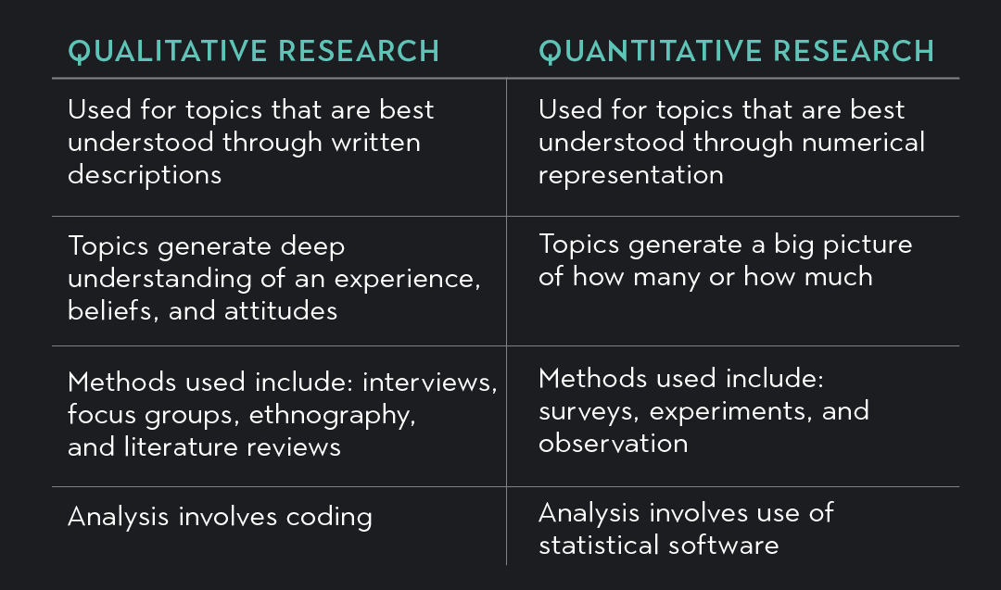
Difference between qualitative and quantitative research

Slide 7
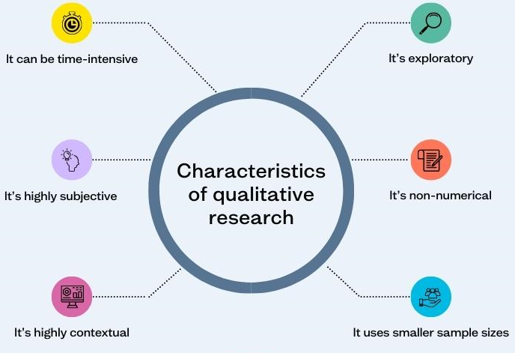

Slide 8
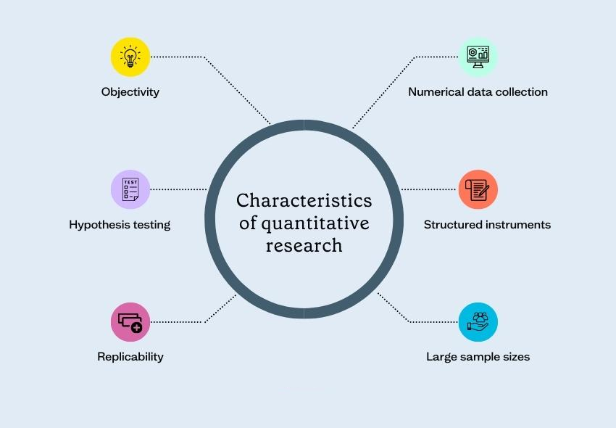

Slide 9
Types of qualitative research
Phenomenological Research is a method focused on describing participants' experiences with a particular phenomenon. It often involves interviews and pattern analysis, with success depending on the participants' ability to clearly articulate their experiences.
Ethnographic Research is a study method based on observing human actions, discourse, and self-perception. It's suitable when experimental research is inappropriate and precision isn't required. Examples of ethnographic research might include: .Researchers observing customers in a supermarket and their interactions with employees.

Slide 10
Types of qualitative research
Grounded theory Research is defined as qualitative naturalistic research in which a theory is derived through the analysis of data. For example, a company with a high attrition rate that has not done any research on this area before may choose grounded theory to understand key reasons why people choose to leave.
Historical Research is defined as the process of investigating past events systematically to provide an account of happenings in the past. The most commonly recognized historical methodologies include: Palaeography (study of historical handwriting), diplomatics, the study of documents, records and archives, chronology (establishing the dates of past events), the study of publications, epigraphy (study of ancient inscriptions).

Slide 11
Types of qualitative research
Case Study Research to an in-depth, detailed study of an individual or a small group of individuals. For example, case studies in medicine may focus on an individual patient or ailment; case studies in business might cover a particular firm's strategy or a broader market.
Action Research is a research method that aims to simultaneously investigate and solve an issue. In other words, as its name suggests, action research conducts research and takes action at the same time. As part of an initiative to improve school facilities for students with disabilities, an action research plan had wheelchair-using students time their travel between various points on school grounds. After gathering the data, students provided input on where ramps or other accessibility measures would be most effective, and these suggestions were submitted to school administrators.

Slide 12
Types of quantitative Research
Survey Research is the collection of information from a sample of individuals through their responses to questions‘.
Descriptive Research is a method that describes the characteristics of the population or phenomenon that is being studied. This methodology focuses more on the “what” of the research subject rather than the “why” of the research subject.
Correlational Research investigates relationships between two variables (or more) without the researcher controlling or manipulating any of them. It's a non-experimental type of quantitative research.

Slide 13
Types of quantitative Research
Quasi-experimental Research aims to establish a cause-and-effect relationship between an independent and dependent variable. However, unlike a true experiment, a quasi-experiment does not rely on random assignment. Instead, subjects are assigned to groups based on non-random criteria.
Experimental Research refers to research where the researcher manipulates the variable to come to an conclusion or finding and it is difficult to do in social sciences due to manipulating variables. It is useful in finding out the cause effect of a casual relationship and correlation.
The main difference between experimental and quasi-experimental research lies in the distribution of respondents into groups. In experimental research, distribution of respondents into groups is randomized to reduce bias. In quasi-experiments, such a random distribution is not possible.

Slide 14
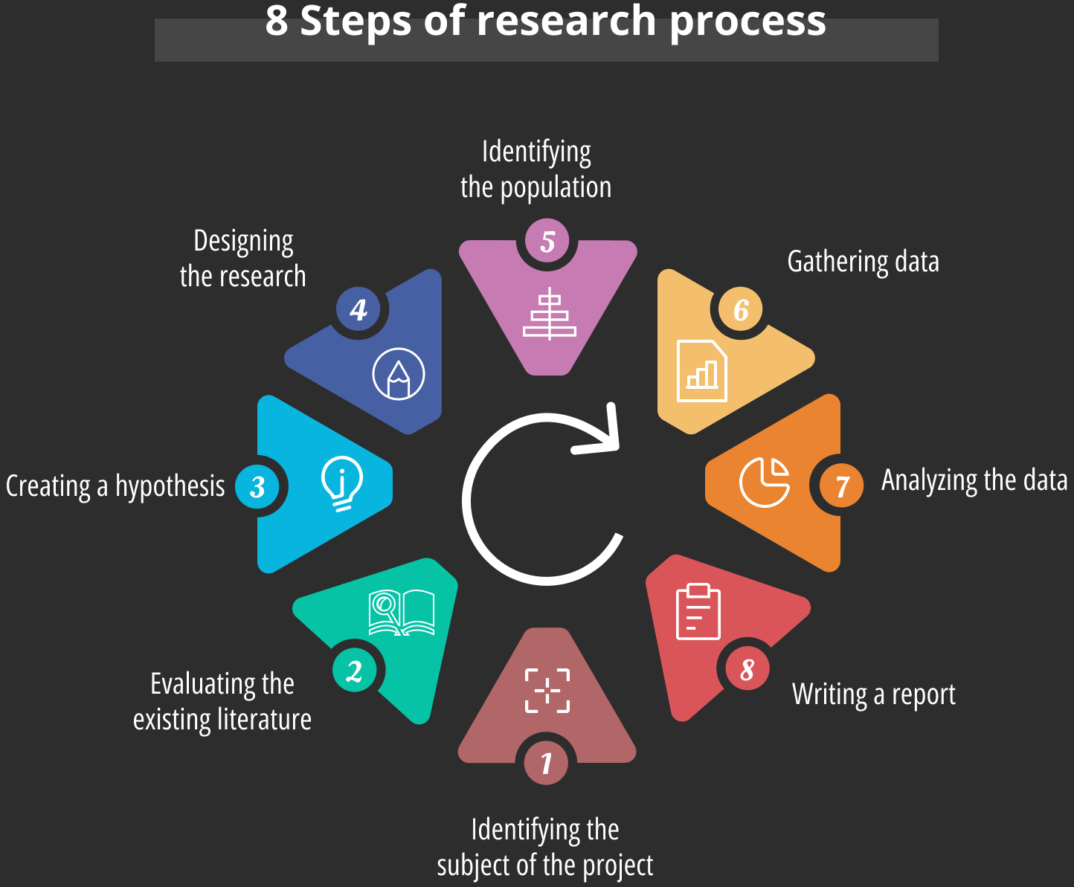

Slide 15
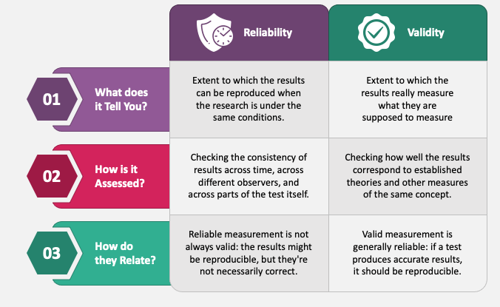
Reliability Vs. Validity

Slide 16
Basic statistics
Statistics is a field of mathematics that pertains to data analysis. Statistical methods and equations can be applied to a data set in order to analyze and interpret results, explain variations in the data, or predict future data.
Mean, which is also known as the average, is the total sum of values in a sample divided by the number of values in your sample. The mean is calculated by summing all the values in a dataset and dividing by the total number of values. For example, add all the numbers together (3 + 11 + 4 + 6 + 8 + 9 + 6 = 47). Then you divide the total sum by the number of scores used (47 / 7 = 6.7).
Median, is the middle point in a dataset—half of the data points are smaller than the median and half of the data points are larger. To find the median: Arrange the data points from smallest to largest. If the number of data points is odd, the median is the middle data point in the list.

Slide 17
Basic Statistics
Mode refers to the most frequently occurring number found in a group of numbers. The mode is determined by collecting data to count the frequency of each result. The result with the highest count of occurrences is known as the mode of the set, which is also commonly referred to as the modal value.
Range, which is the difference between the largest and smallest value in the data set, describes how well the central tendency represents the data. If the range is large, the central tendency is not as representative of the data as it would be if the range was small.
The standard deviation is the average amount of variability in your dataset. It tells you, on average, how far each value lies from the mean. A high standard deviation means that values are generally far from the mean, while a low standard deviation indicates that values are clustered close to the mean.

